Slide 1
Grid Systems – UTM Projection
Dr. Kaustuv Mukherjee
Assistant Professor
Dept. of Geography
Chandidas Mahavidyalaya

Slide 2
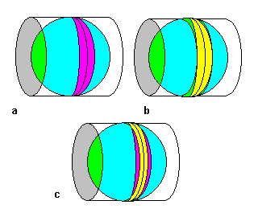
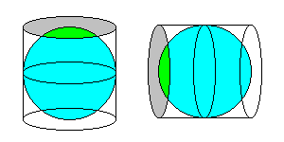
Transverse Mercator Projection

Slide 3
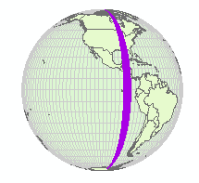
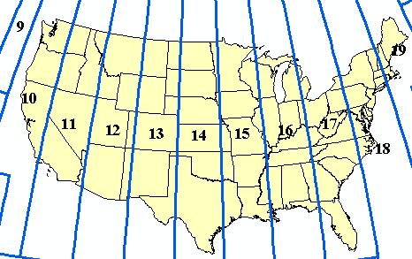
Universal Transverse Mercator
South Dakota
Zone 16
Based on Transverse Mercator (cylindrical) projection
World divided into 60 zones 6 degrees wide
Distortion is minimal within each zone
Maps of different areas use best zone
Best for maps covering small area in one zone

Slide 4
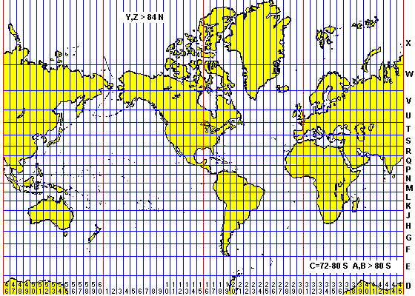
UTM Zones

Slide 5
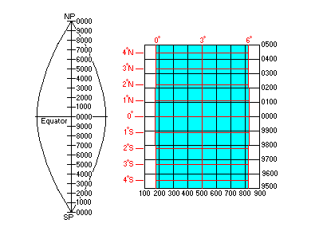
UTM Pole to Pole

Slide 6
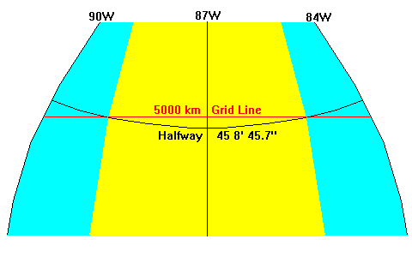
Halfway to the Pole

Slide 7
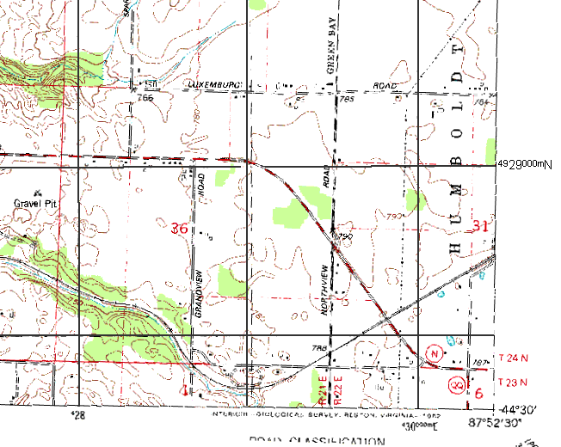
Using UTM

Slide 8
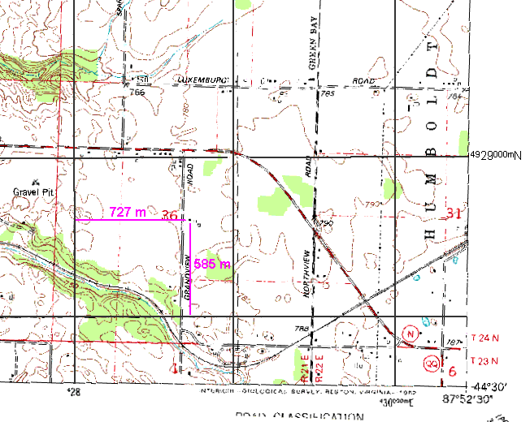
Using UTM

Slide 9
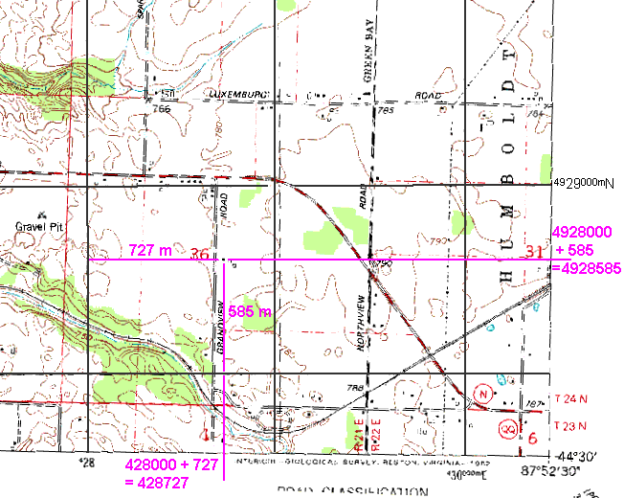
Using UTM

Slide 10
Three Kinds of North
True North – Along Meridians
Magnetic North – What a compass detects
  Important in field
  Not important in most GIS
Grid North – Along N-S grid lines
  Minor importance for compass work
  Be aware there’s a difference!
  Military uses exclusively

Slide 11
Cautions About UTM
Military maps use two letter codes for each 100-km square, but maps will have information to enable conventional UTM
With military grid references, number of digits indicates level of precision
Older maps will sometimes have obsolete grids
Datum, datum, datum!

Slide 12
Military Grid System
45N 89 W = E 342,369, N 4,984,896 Zone 16T
Digraph = CQ
1 km accuracy = 16T CQ 42 84
100 m accuracy = 16T CQ 423 848
10 m accuracy = 16T CQ 4236 8489
1 m accuracy = 16T CQ 42369 84896
Ticks on USGS topo map = 342,000, 4,984,000

Slide 13
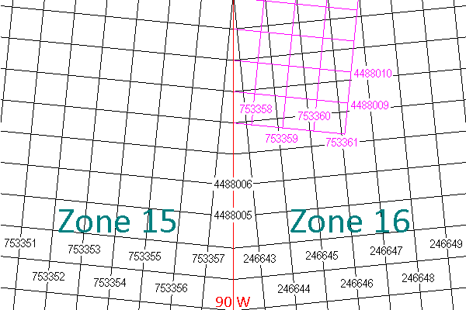
Where Zones Meet

Slide 14
Why a Grid?
Latitude /Longitude | Grid System
North varies from place to place on the map | Grid north is always the same direction
Angular units differ in scale between N-S and E-W | Grid scale the same in all directions
E-W angular units vary in scale with latitude | Grid squares are always the same size and shape
Hexadecimal Scale | Decimal Scale

Slide 15
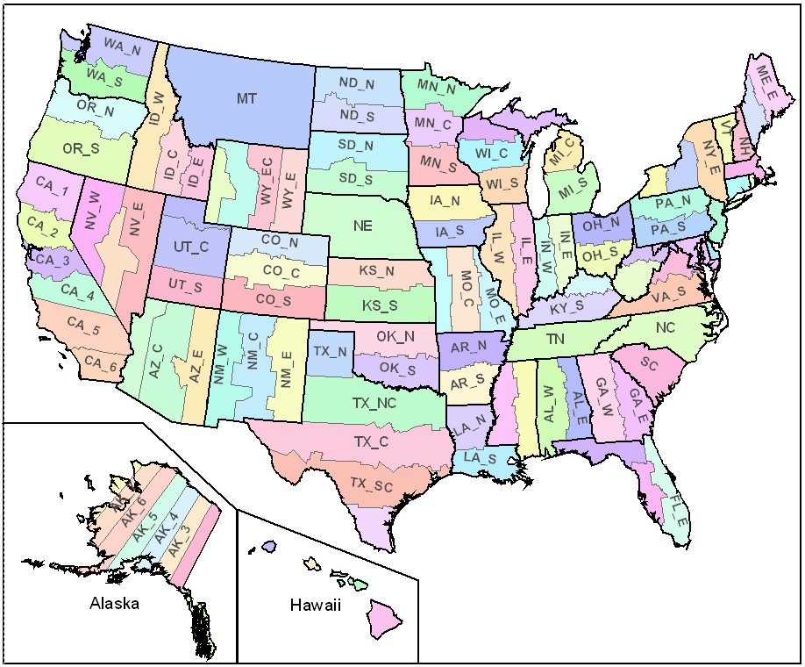
State Plane System
States divided into one or more zones identified by a unique FIPS number
Uses several types of projections
E-W zones generally Conic, N-S zones generally UTM

Slide 16
Projections for large scale maps
Local, city, county maps, smaller states
  Projection systems virtually eliminate distortion
  Choose appropriate UTM or State Plane zone

Slide 17

… further reading continues.
Thank You

